Slide 1
Data Type Conversion

Slide 2
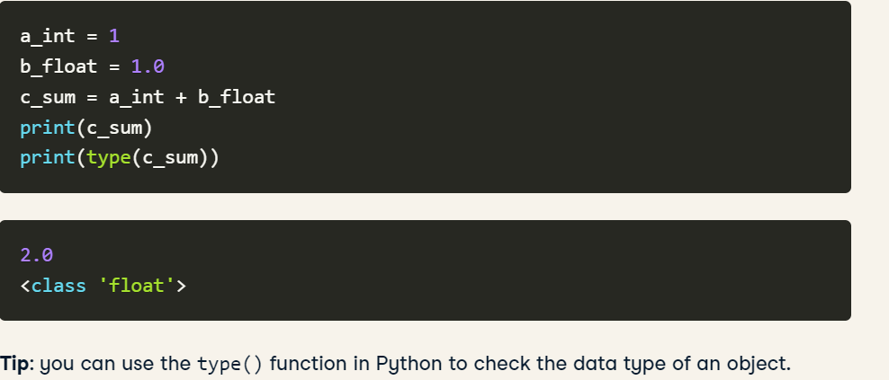
Python has many data types. You must have already seen and worked with some of them.
You have integers and float to deal with numerical values, boolean (bool) to deal with true/false values
and strings to work with alphanumeric characters.
You can make use of lists, tuples, dictionary, and sets that are data structures where you can store a collection of values.
Python Implicit Data Type Conversion

Slide 3
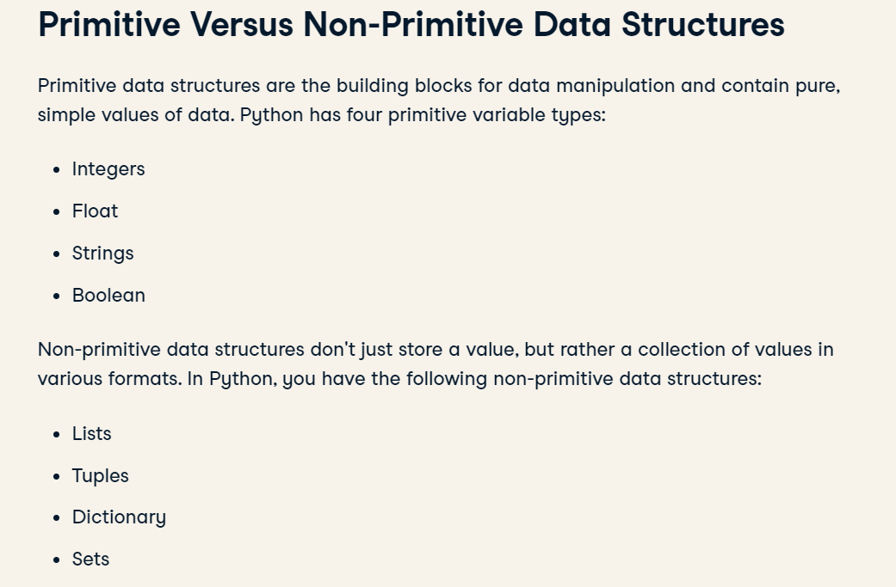

Slide 4
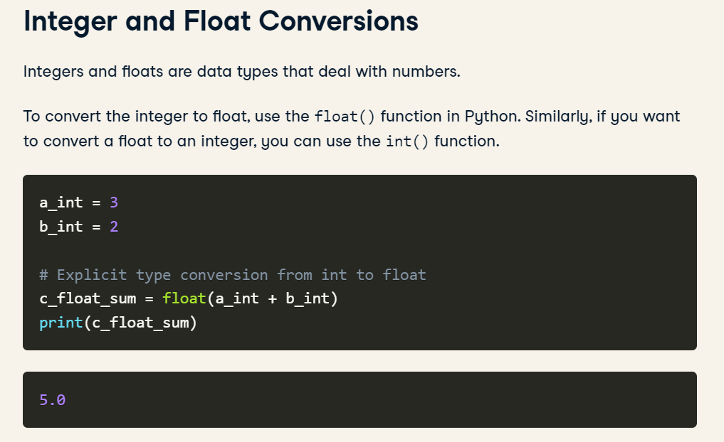

Slide 5
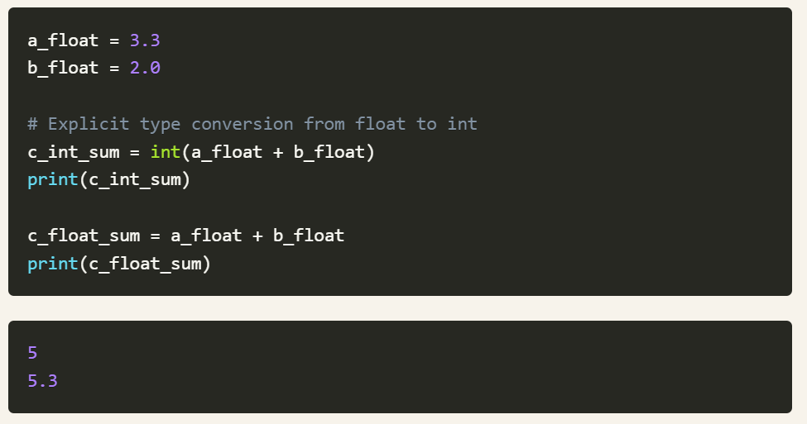

Slide 6
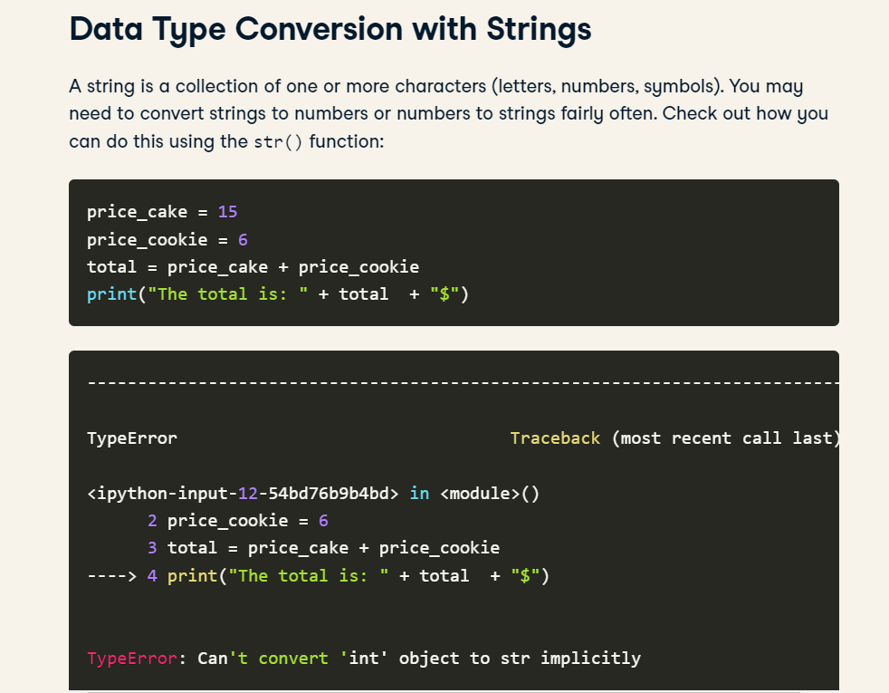

Slide 7
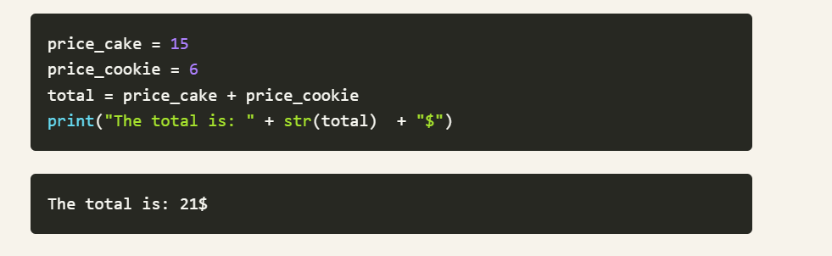
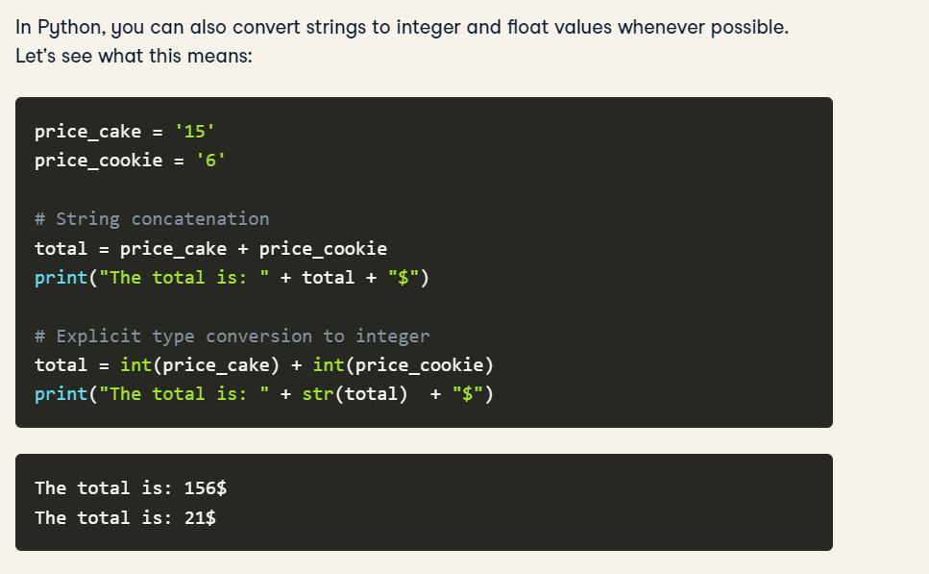

Slide 8
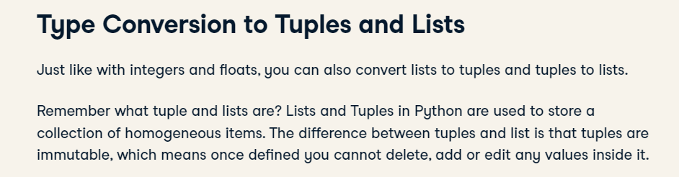
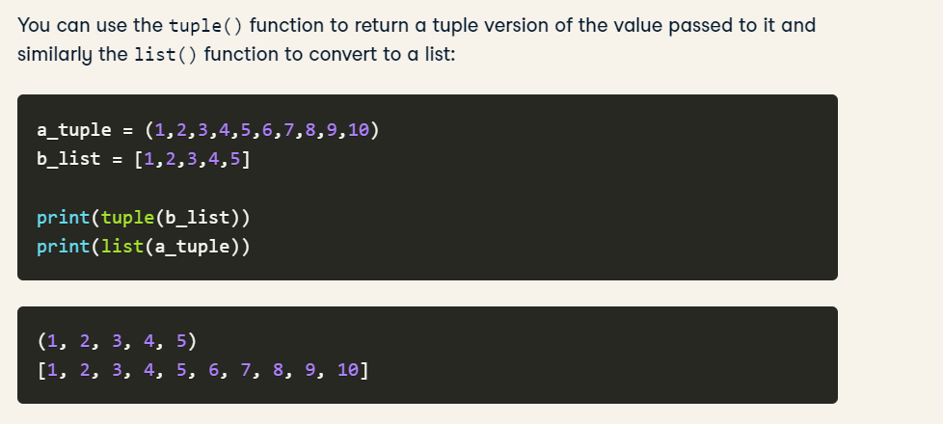

Slide 9
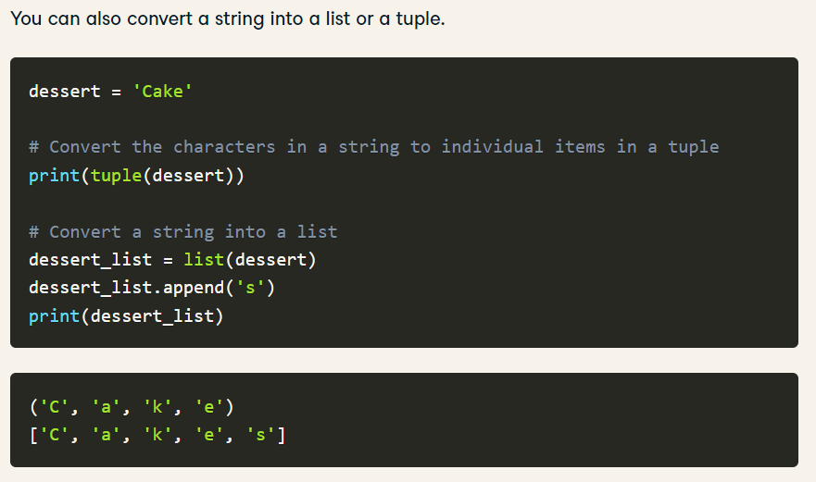

Slide 10
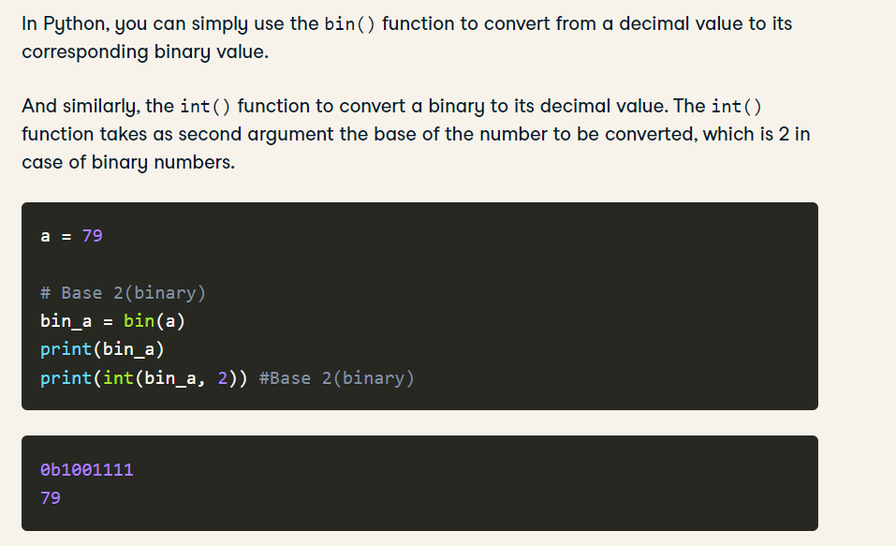
Convert to Binary Number
Binary integers are the number represented with base two. Which means in the binary number system, there are only two symbols used to represent numbers: 0 and 1.

Slide 11
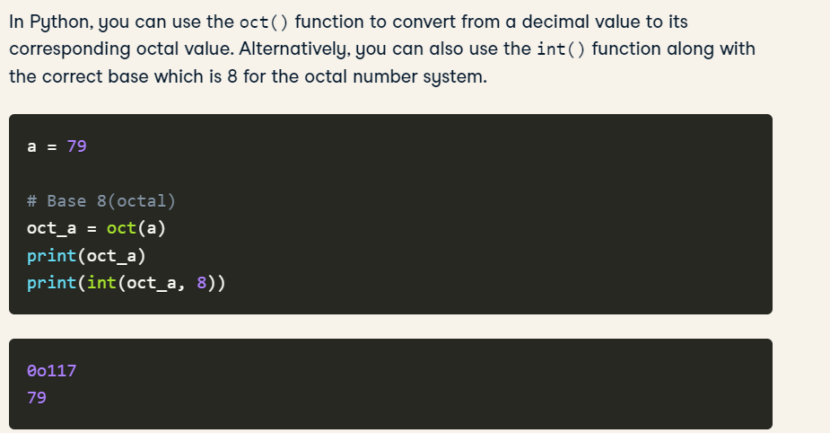

Slide 12

